Slide 1

Telecom Customer Intelligence System
Clustering, Classification & Regression using ML Pipelines
Presented by: Mohammed Hayath R K

Slide 2

Addressing Critical Business Needs
1
2
Customer Segmentation
Churn Prediction
Identifying at-risk customers to proactively prevent attrition.
Understanding diverse customer groups for personalized engagement.
3
Revenue Estimation
Forecasting monthly charges for strategic financial planning.

Slide 3

Project Objectives
1
Segment Customers Effectively
To group customers based on behavior and demographics, enabling tailored strategies.
2
Predict Customer Churn
To develop a robust model that accurately forecasts customer churn.
3
Estimate Monthly Charges
To build a predictive model for monthly revenue estimation per customer.

Slide 4

Data & Preprocessing Foundation
Telco Customer Churn Dataset
Leveraging comprehensive telecom customer data.
Ensuring data quality through robust cleaning methods.
Preprocessing Pipeline
Strategic handling of missing values for data integrity.
Feature scaling and categorical encoding for model readiness.
Efficient, pipeline-based preprocessing for reproducibility.

Slide 5


Machine Learning Models Utilized
Clustering: KMeans
Utilizing KMeans for customer segmentation, evaluated by Silhouette Score.
Classification: Random Forest
Employing Random Forest for churn prediction, measured by Accuracy.
Regression: Linear Regression
Applying Linear Regression for monthly charge estimation, assessed by RMSE and R².

Slide 6
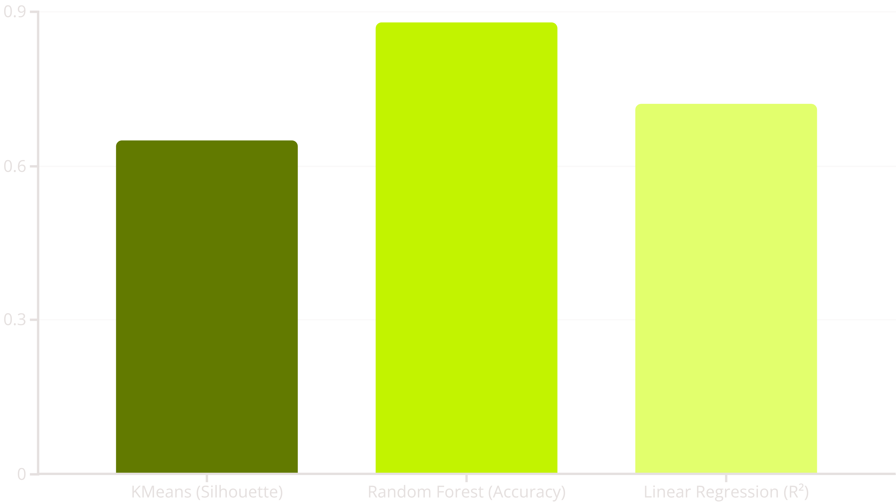
Model Performance at a Glance
This chart summarizes the key performance indicators for each model, demonstrating their effectiveness in achieving the project objectives. Our Random Forest model achieved an 88% accuracy in predicting churn.

Slide 7

Driving Business Impact
Improved Customer Retention
1
Proactive identification of churn risk leads to tailored retention campaigns.
Targeted Marketing Strategies
2
Segmentation enables highly personalized and effective marketing initiatives.
Enhanced Revenue Forecasting
3
Accurate estimation of monthly charges supports better financial planning and resource allocation.

Slide 8
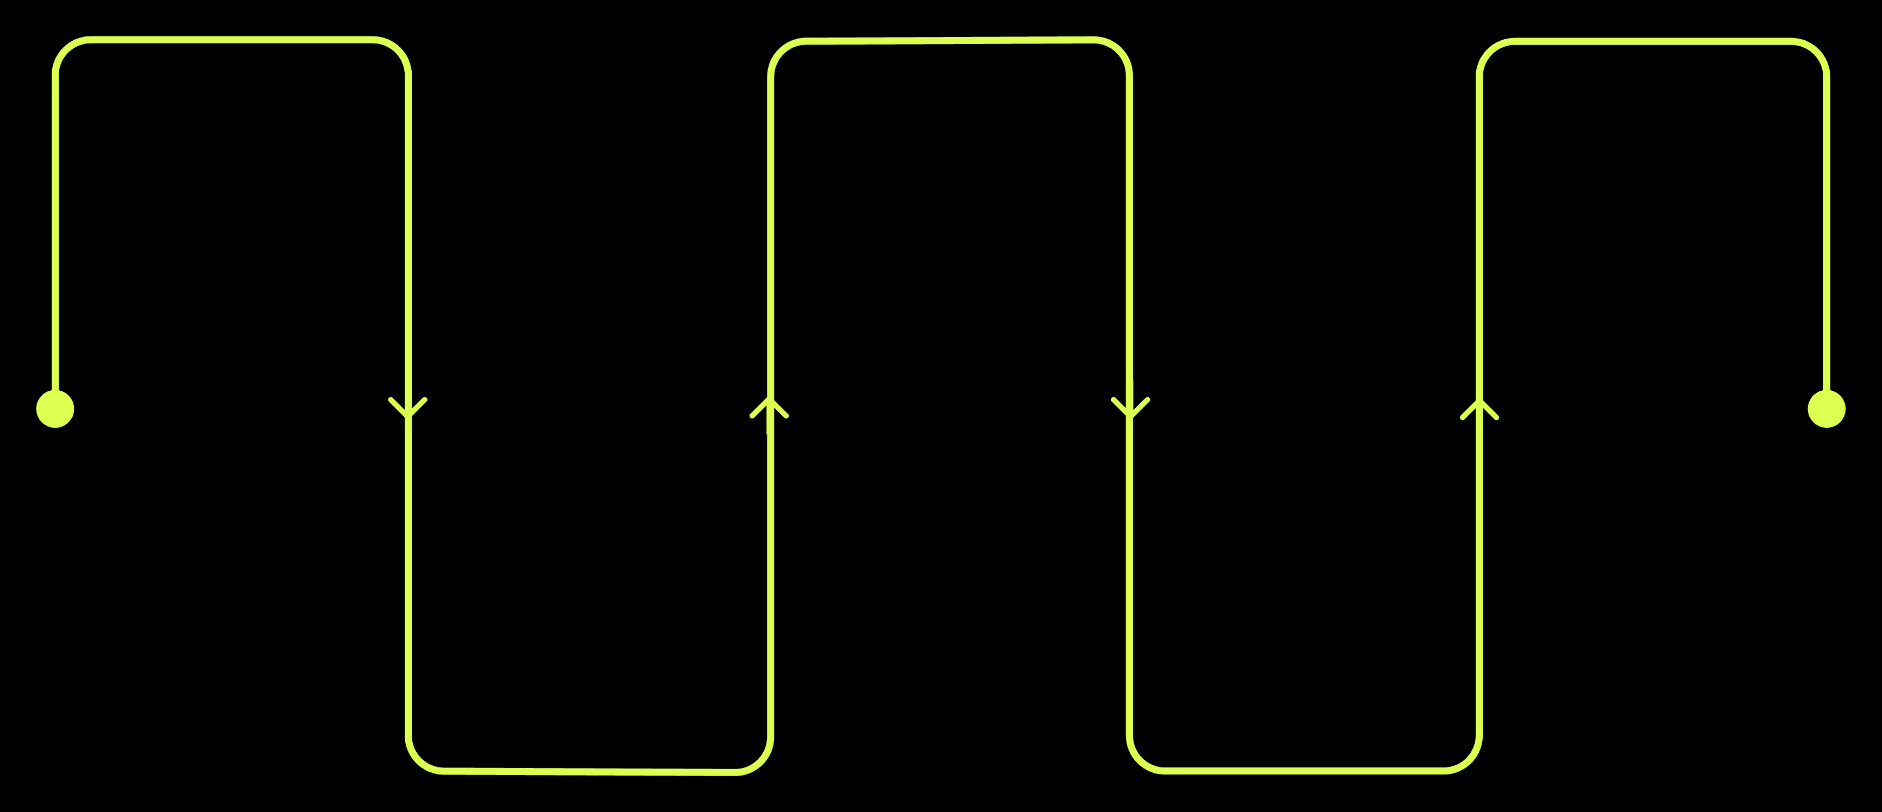
The Power of an End-to-End ML Pipeline
Data Ingestion
Model Training
Deployment
Deliver models to production
Collect raw data from sources
Train models and tune parameters
Preprocessing
Evaluation
Validate performance and metrics
Clean, normalize, and transform
Our project successfully implemented an end-to-end machine learning pipeline, streamlining the process from raw data to actionable insights. This robust framework ensures consistency and efficiency.

Slide 9

Conclusion & Future Directions
Project Accomplishments
Successfully implemented an end-to-end ML pipeline.
Achieved promising results in customer segmentation, churn prediction, and revenue estimation.
Future Enhancements
Advanced hyperparameter tuning for further model optimization.
Development of an interactive dashboard for real-time monitoring.
Deployment of models into a production environment for continuous impact.

Slide 10

Thank You
Questions & Discussion

